Slide 1

Coffee House App Design
Komal Mathur Gupta

Slide 2
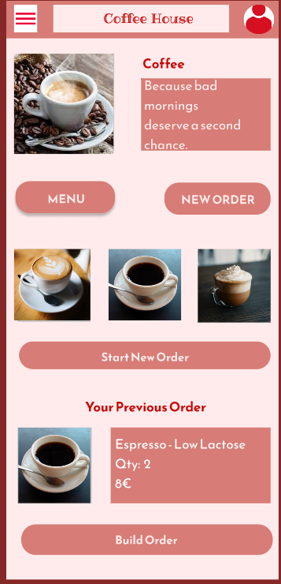
Project overview
The product:
We're creating a Coffee app to attract and retain customers in our online system. We noticed that our competitors offer dedicated mobile apps for their customers to order through, and they have been very successful. We want to create a product that can compete in the market, improve sales, and increase customer satisfaction.
Preview of selected polished designs.
Project duration:
Insert the time that you worked on this design project - e.g., Month Year to Month Year

Slide 3
Project overview
The problem:
Busy workers and commuters lack the time necessary to prepare a coffee.
The goal:
Design an app for Coffee House that allows users to easily order and pick up fresh coffee according to their choice..

Slide 4
Project overview
My role:
IUX designer designing an app for Coffee House from conception to delivery.
Responsibilities:
Conducting interviews, paper and digital wireframing, low and high-fidelity prototyping, conducting usability studies, accounting for accessibility, and iterating on designs.

Slide 5
User research
Personas
Problem statements
User journey maps
Understanding
the user

Slide 6
User research: summary
I conducted interviews and created empathy maps to understand the users I’m designing for and their needs. A primary user group identified through research was working adults.
This user group confirmed initial assumptions about Coffee House customers.

Slide 7
User research: pain points
1
2
3
Time
Accessibility
Pain point
Working adults are too busy to spend time on preparing anything for them.
Platforms for ordering coffee are not equipped with assistive technologies
Text-heavy menus in apps are often difficult to read and order from

Slide 8
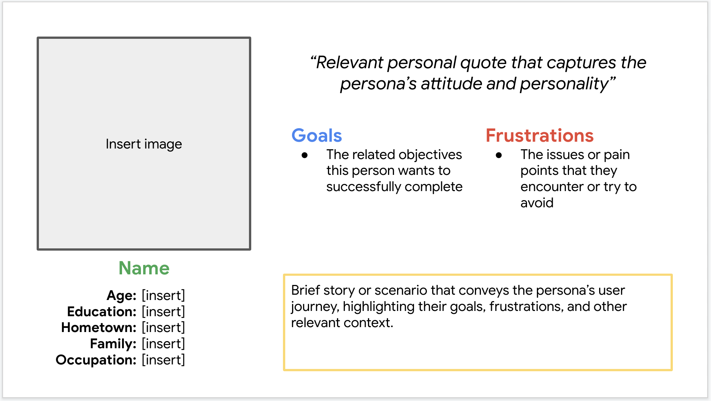
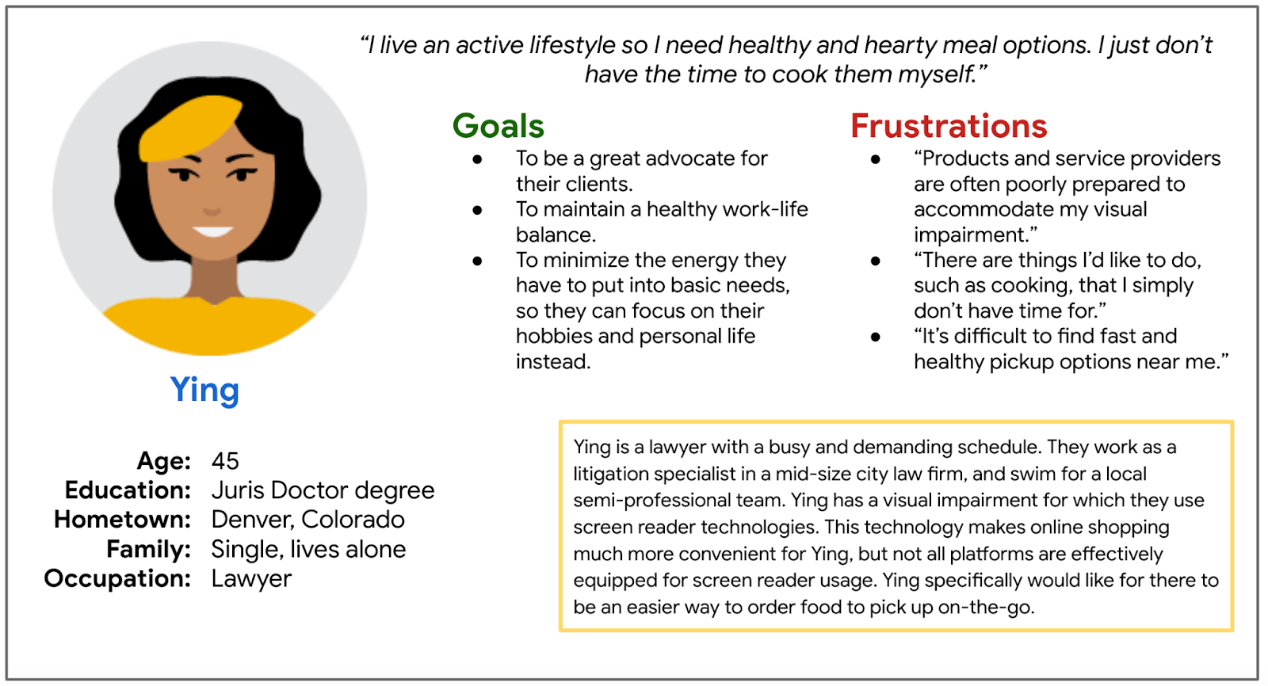
Persona: Name
Problem statement:
Ying is a busy working adult who needs easy access to good coffee ordering options because he is addicted to coffee and needs it on time to time basis to energize herself.

Slide 9
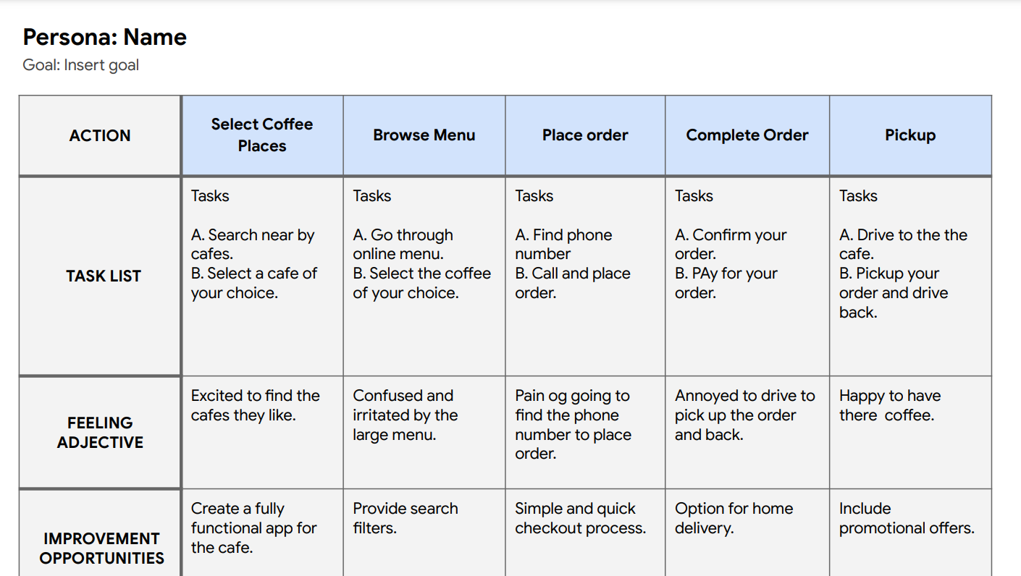
User journey map
Mapping Ying’s user journey revealed how helpful it would be for users to have access to a dedicated Coffee app.
Image of user journey map

Slide 10
Paper wireframes
Digital wireframes
Low-fidelity prototype
Usability studies
Starting
the design

Slide 11
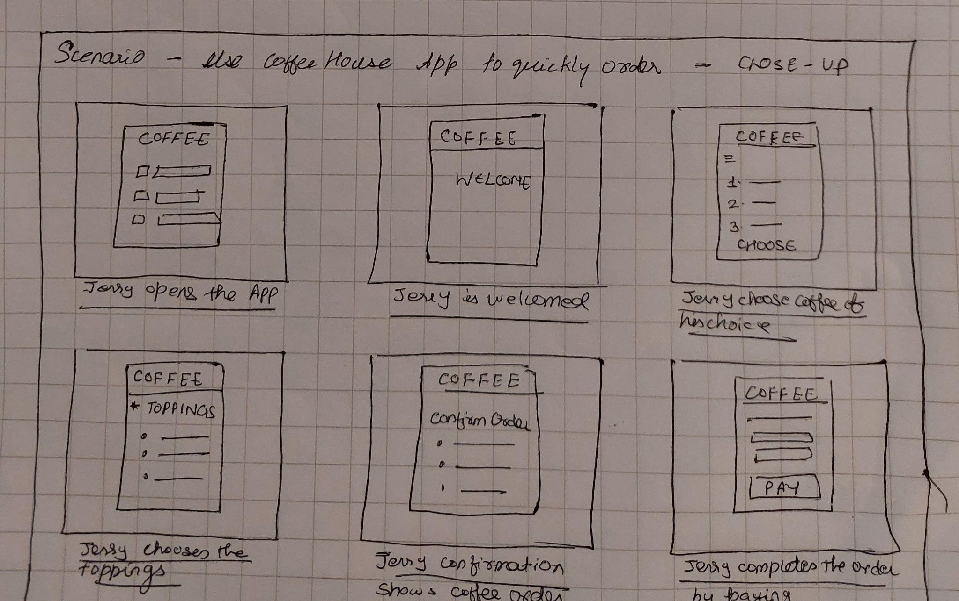
Paper wireframes
Taking the time to draft iterations of each screen of the app on paper ensured that the elements that made it to digital wireframes would be well-suited to address user pain points. For the home screen, I prioritized a quick and easy ordering process to help users save time.
Image of paper wireframes including five different versions of the same screen and one image of the new, refined version

Slide 12
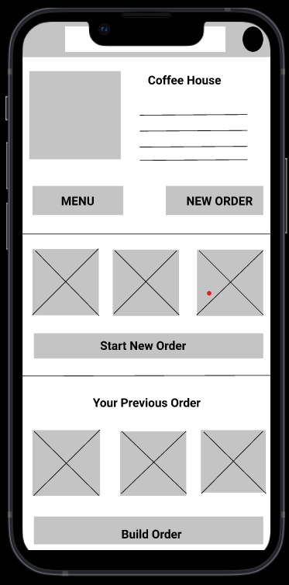
Digital wireframes
[As the initial design phase continued, I made sure to base screen designs on feedback and findings from the user research.
Insert first wireframe example that demonstrates design thinking aligned with user research
This button home screen makes it fast and easy for users to order.
This button provides an easy option for users to make their own coffee.

Slide 13
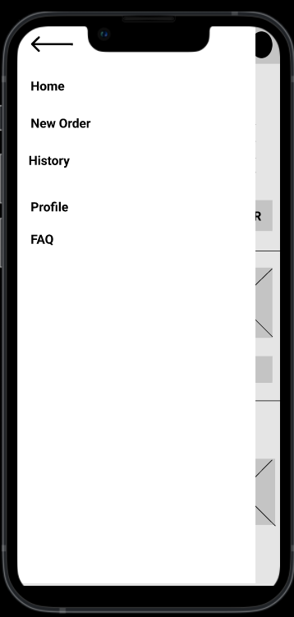
Digital wireframes
Easy access to navigation that’s screen reader friendly.
Easy navigation was a key user need to address in the designs in addition to equipping the app to work with assistive technologies.
Insert second wireframe example that demonstrates design thinking aligned with user research

Slide 14
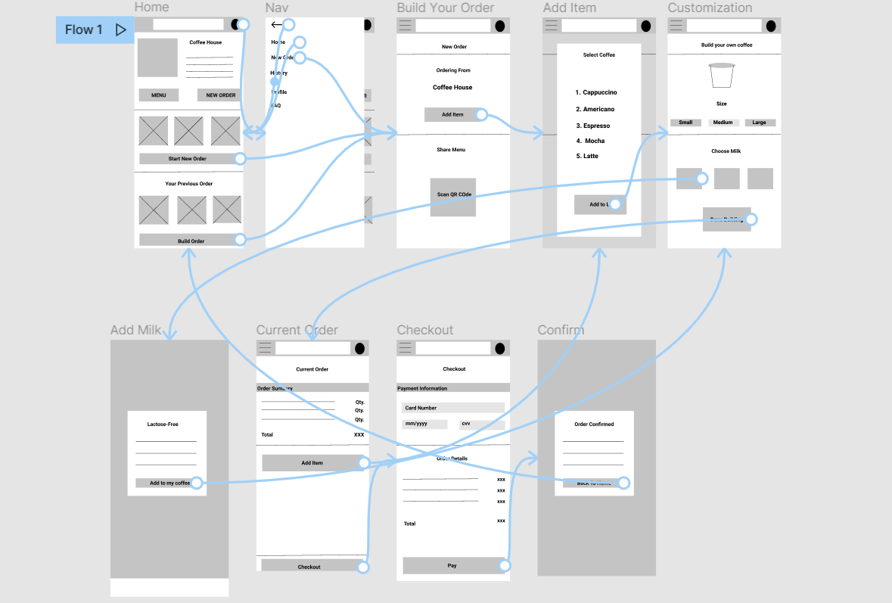
Low-fidelity prototype
Using the completed set of digital wireframes, I created a low-fidelity prototype. The primary user flow I connected was building and ordering a coffee, so the prototype could be used in a usability study.
View the CoffeeHouse low-fidelity prototype
Screenshot of prototype with connections or prototype GIF

Slide 15
Usability study: findings
I conducted two rounds of usability studies. Findings from the first study helped guide the designs from wireframes to mockups. The second study used a high-fidelity prototype and revealed what aspects of the mockups needed refining.
Round 1 findings
Round 2 findings
1
Users want to order coffee quickly
1
“Build your own” functionality is confusing
2
Users want more customization options
2
Checkout process has to many steps
3
Users want a delivery option

Slide 16
Refining
the design
Mockups
High-fidelity prototype
Accessibility

Slide 17
Mockups
Before usability study
After usability study
Early designs allowed for some customization, but after the usability studies, I added additional options to choose milk. I also revised the design so users see all the customization options.
Image of selected screen before usability study
Image of selected screen after usability study

Slide 18
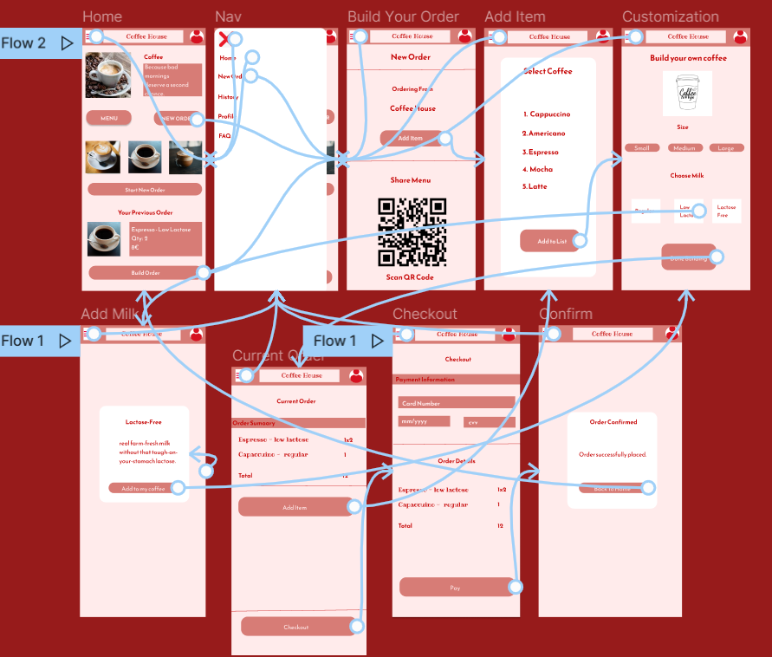
High-fidelity prototype
The final high-fidelity prototype presented cleaner user flows for building a coffee and checkout. It also meet user needs for a pickup or delivery option as well as more customization.
View the Coffee House
high-fidelity prototype
Screenshot of prototype with connections or prototype GIF

Slide 19
Accessibility considerations
1
2
3
Provided access to users who are vision impaired through adding alt text to images for screen readers.
Used icons to help make navigation easier.
Used detailed imagery for coffee and milk to help all users better understand the designs.

Slide 20
Going forward
Takeaways
Next steps

Slide 21
Takeaways
Impact:
The app makes users feel like Coffee House really thinks about how to meet their needs.
One quote from peer feedback:
“The app made it so easy and fun to build my own coffee! ”
What I learned:
While designing the Coffee House app, I learned that the first ideas for the app are only the beginning of the process. Usability studies and peer feedback influenced each iteration of the app’s designs.

Slide 22
Next steps
1
2
Conduct another round of usability studies to validate whether the pain points users experienced have been effectively addressed.
Conduct more user research to determine any new areas of need.

Slide 23
Insert a few sentences summarizing the next steps you would take with this project and why. Feel free to organize next steps in a bullet point list.
Let’s connect!
Thank you for your time reviewing my work on the Coffee House app! If you’d like to see more or get in touch, my contact information is provided below.
Email: komal.mathur0712@gmail.com

